Slide 1
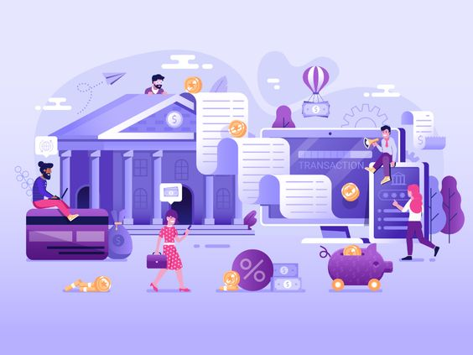
GLOBAL BANK USER MANAGEMENT
Right Bank. Right Now! At your comfort!!

Slide 2
Presented by GROUP 2
MADHAN METTUKURU
AKSHAY MADGUNI
Guided By:
Rajasekhar Sir
VIVEK SINGH
CHARMIE RAJAN
SHREYASH BAPODIA

Slide 3

PROBLEM STATEMENT
User can register themselves to the application
User can apply for the loan
User can withdraw/deposit amount
User can check their balance.
User can view their statement

Slide 4

AIM OF THE PROJECT
It enables bank customers to register themselves as new customer and login to see their details.
It helps them to deposit or withdraw money from their bank account.
At anytime user can see their account balance and available loan balance.
It helps them to apply for loan online.
User can also view their account statement for a particular date range.

Slide 5
TECHNOLOGIES USED
Spring boot
React Js
CSS3
HTML5
JPA( Java Persistence API)
Postman
MySQL

Slide 6
PROJECT MODULES
Registration and Login
User Menu
Transactions
View Statement
Loan

Slide 7
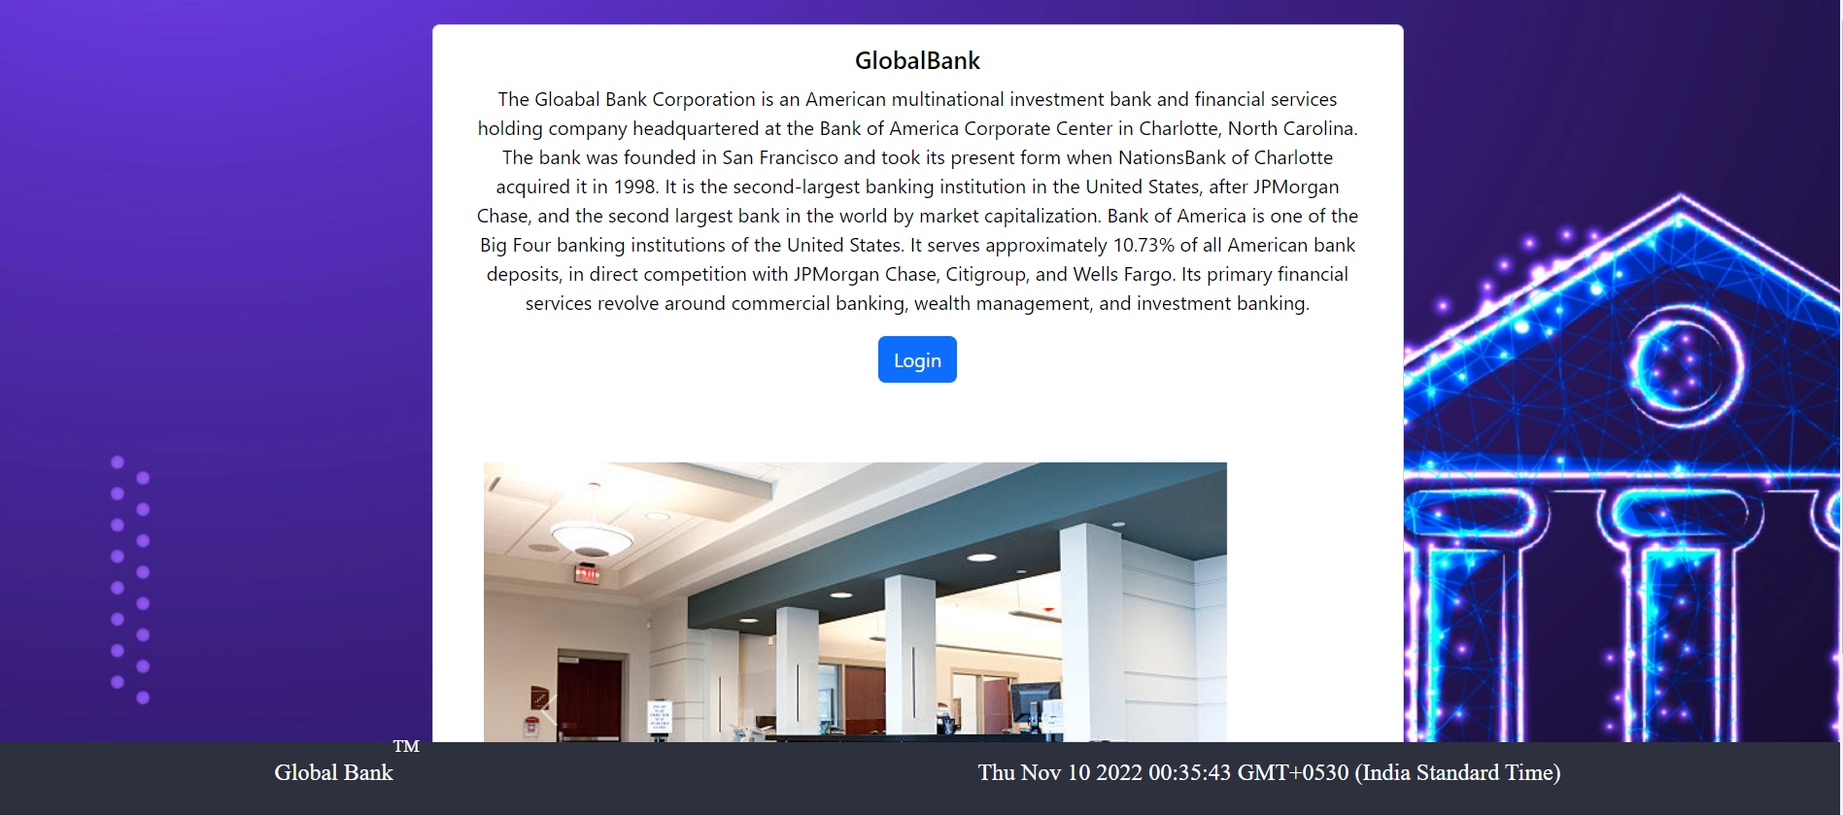
HOME PAGE

Slide 8
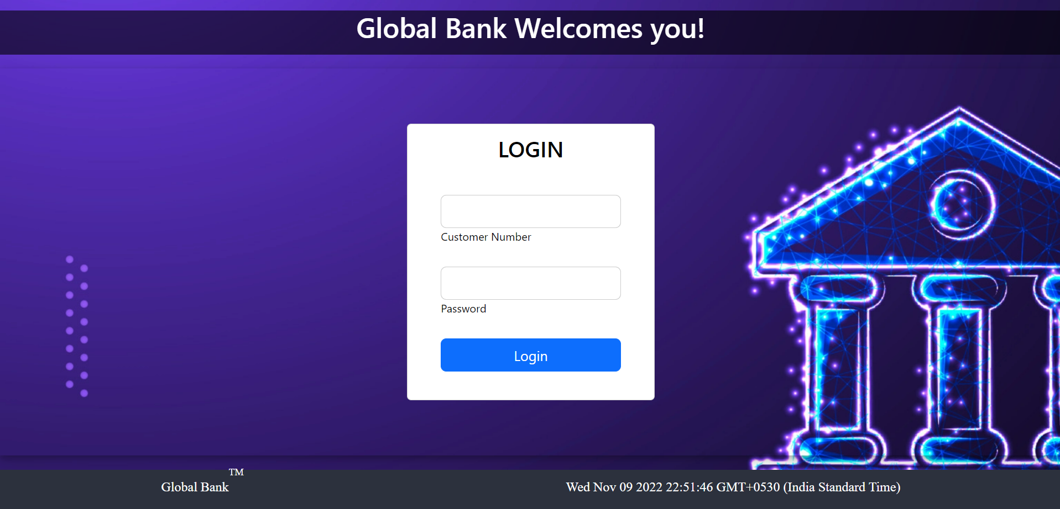
LOGIN PAGE

Slide 9
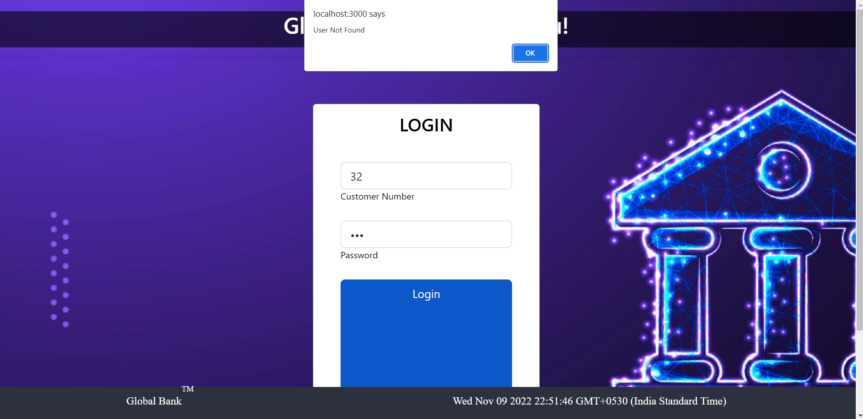
INVALID USER PROMPT

Slide 10
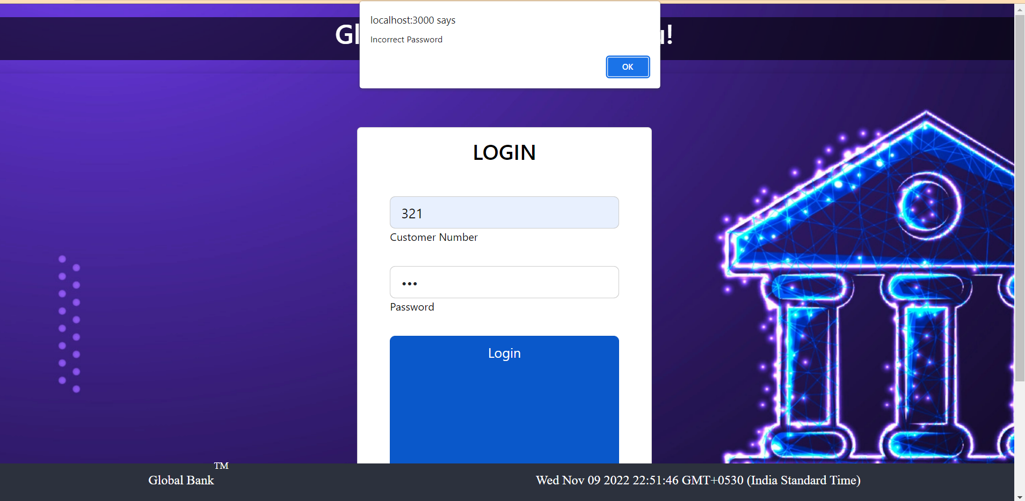
INCORRECT PASSWORD PROMPT

Slide 11
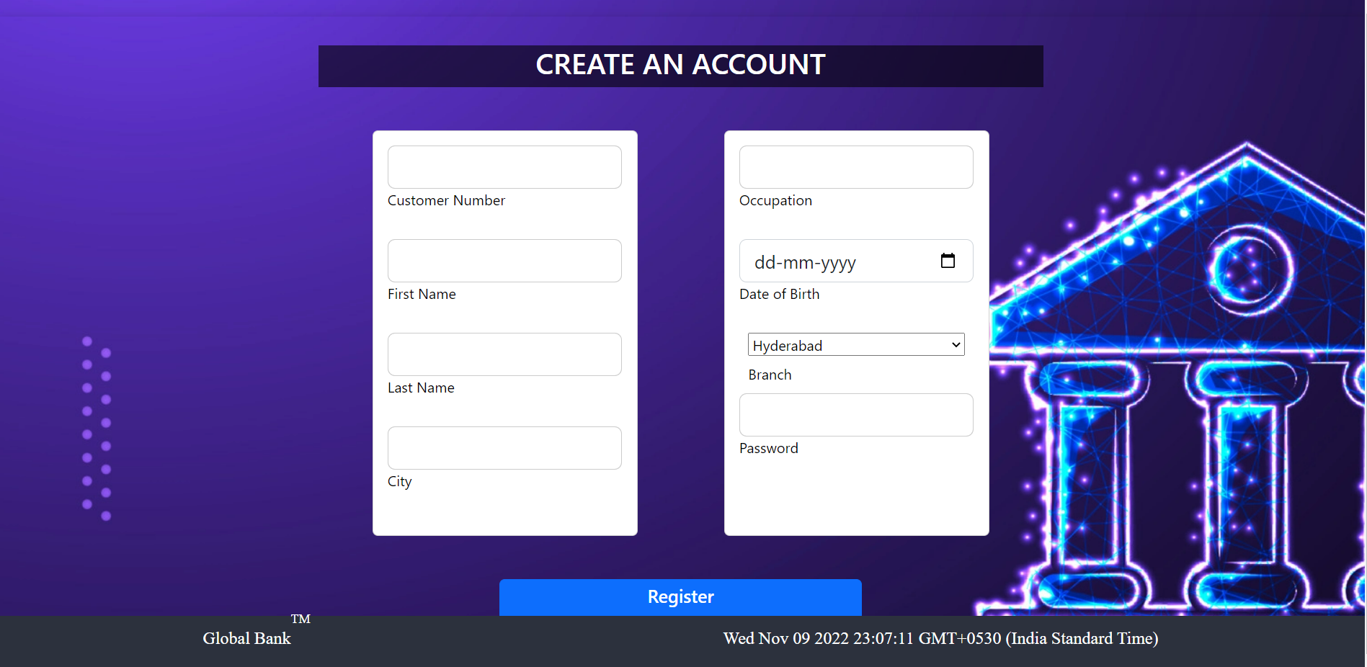
REGISTRATION PAGE

Slide 12
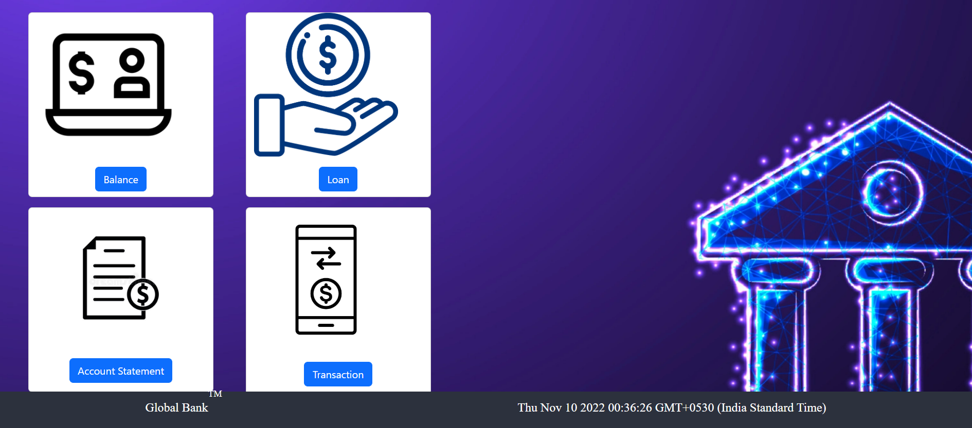
USER MENU

Slide 13
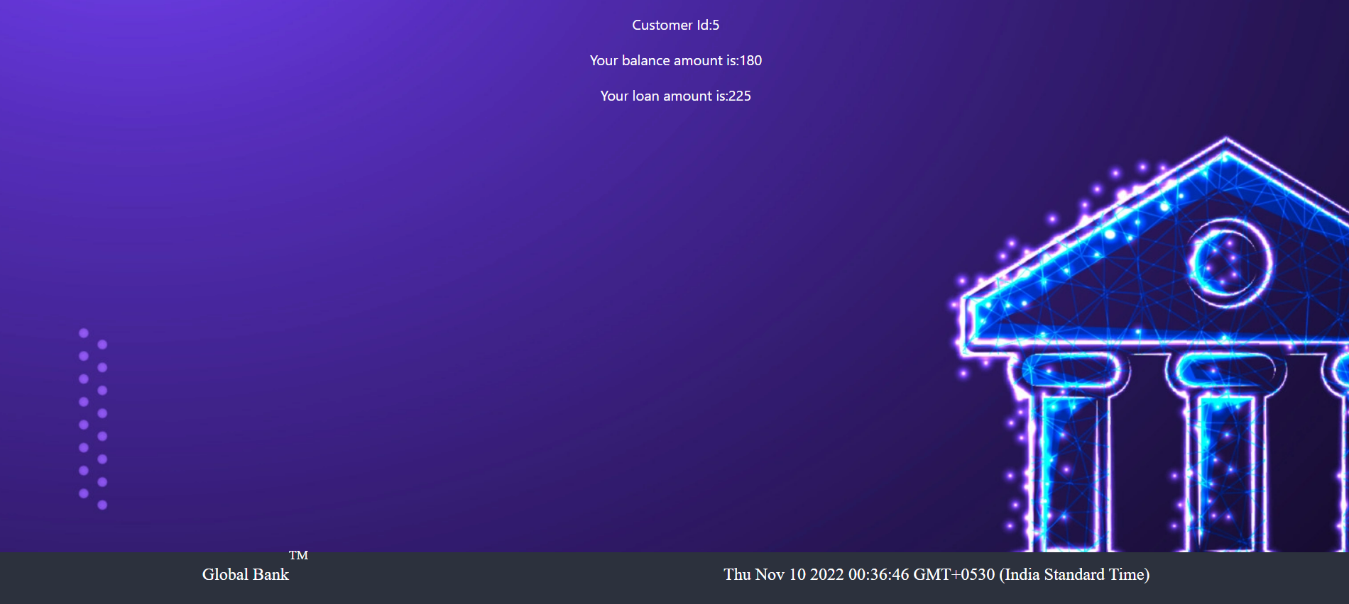
VIEW BALANCE PAGE

Slide 14
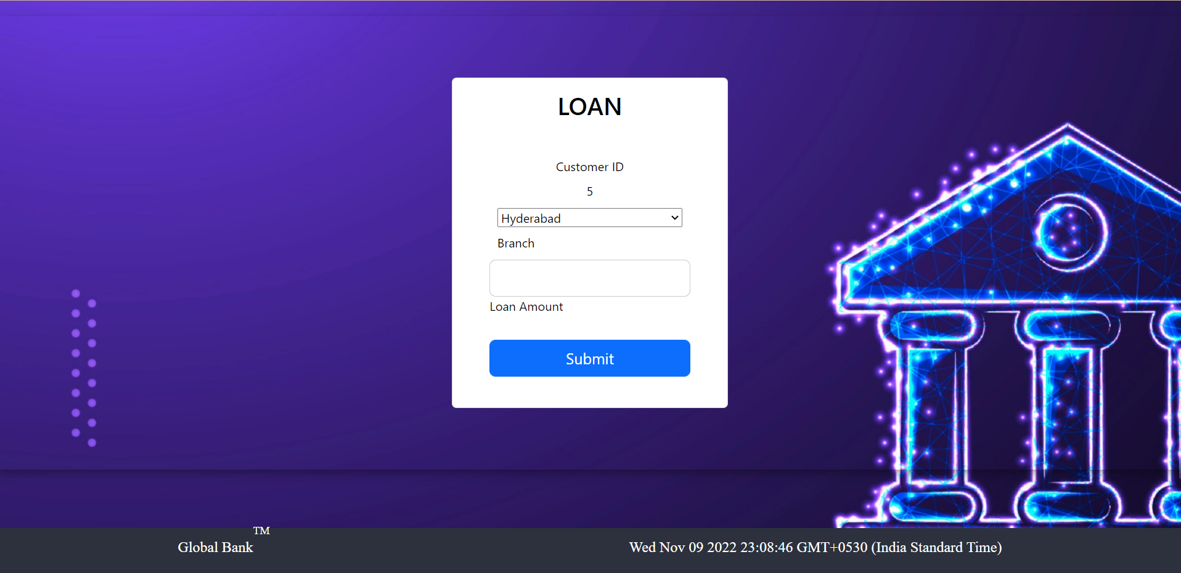
LOAN APPLICATION PAGE

Slide 15
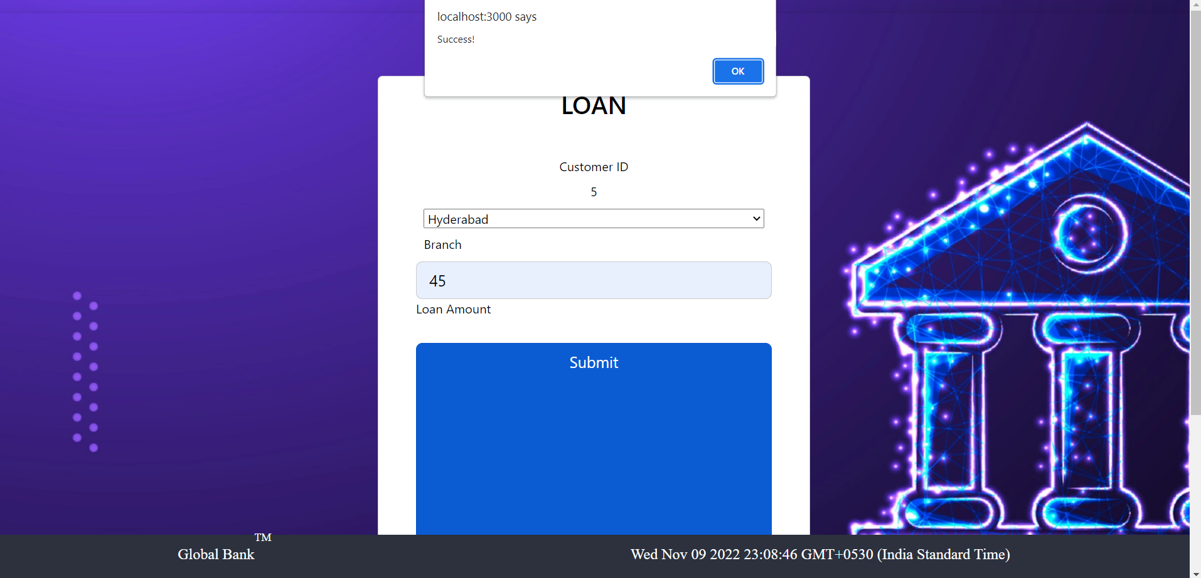
SUCCESS PROMPT FOR LOAN APPLICATION

Slide 16
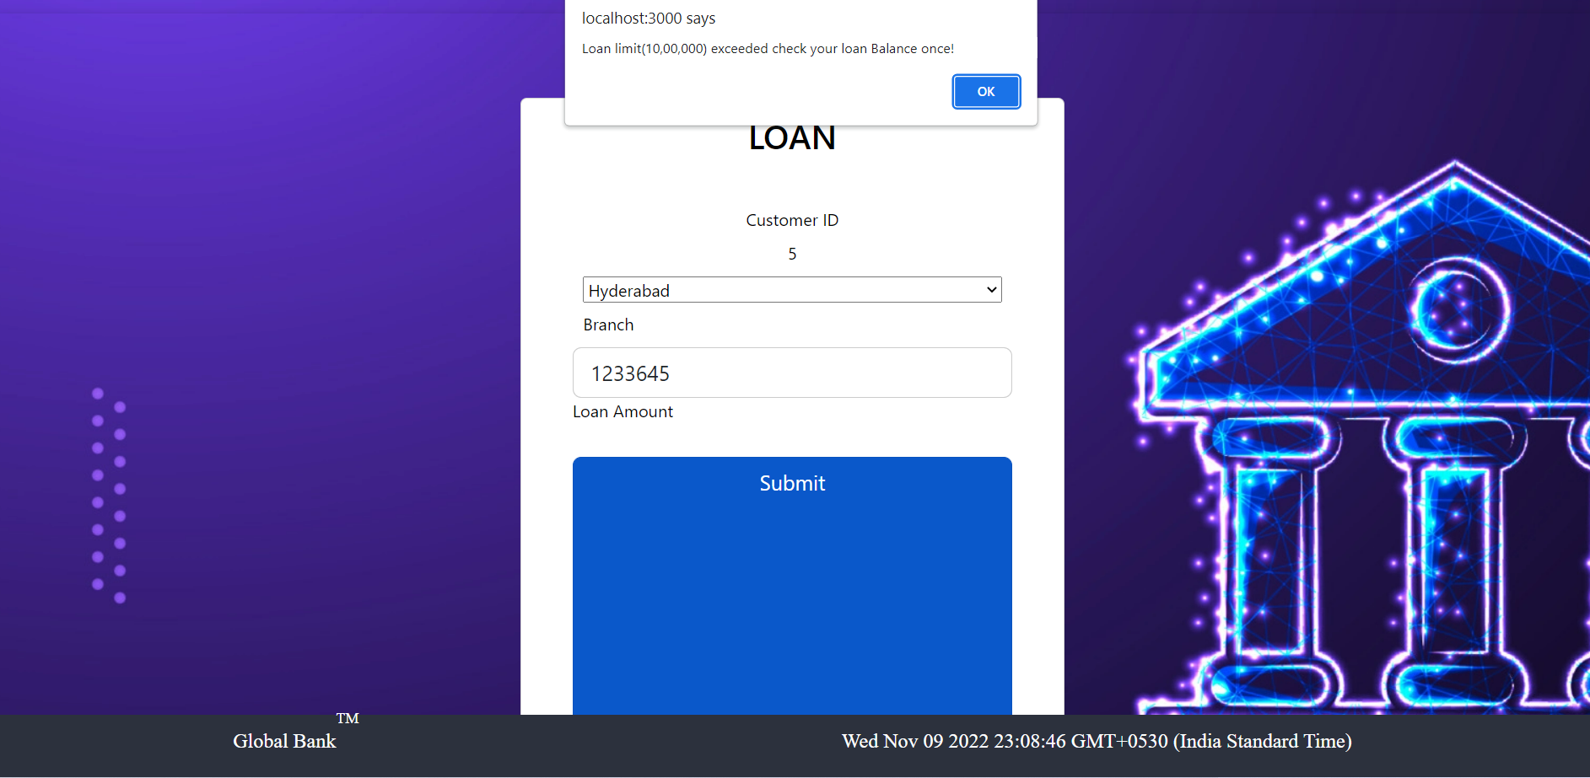
PROMPT FOR LOAN LIMIT EXCEEDED

Slide 17
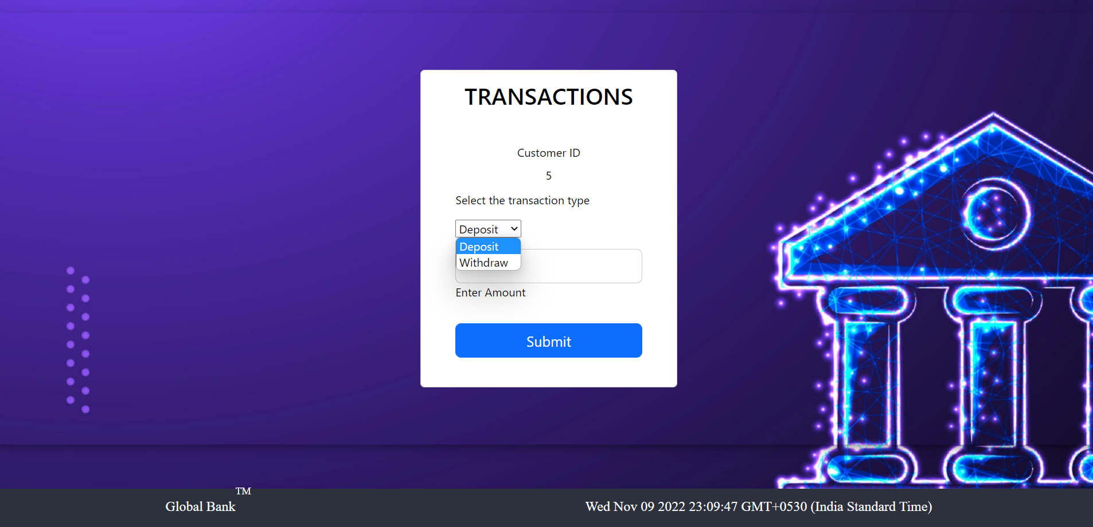
TRANSACTIONS PAGE

Slide 18
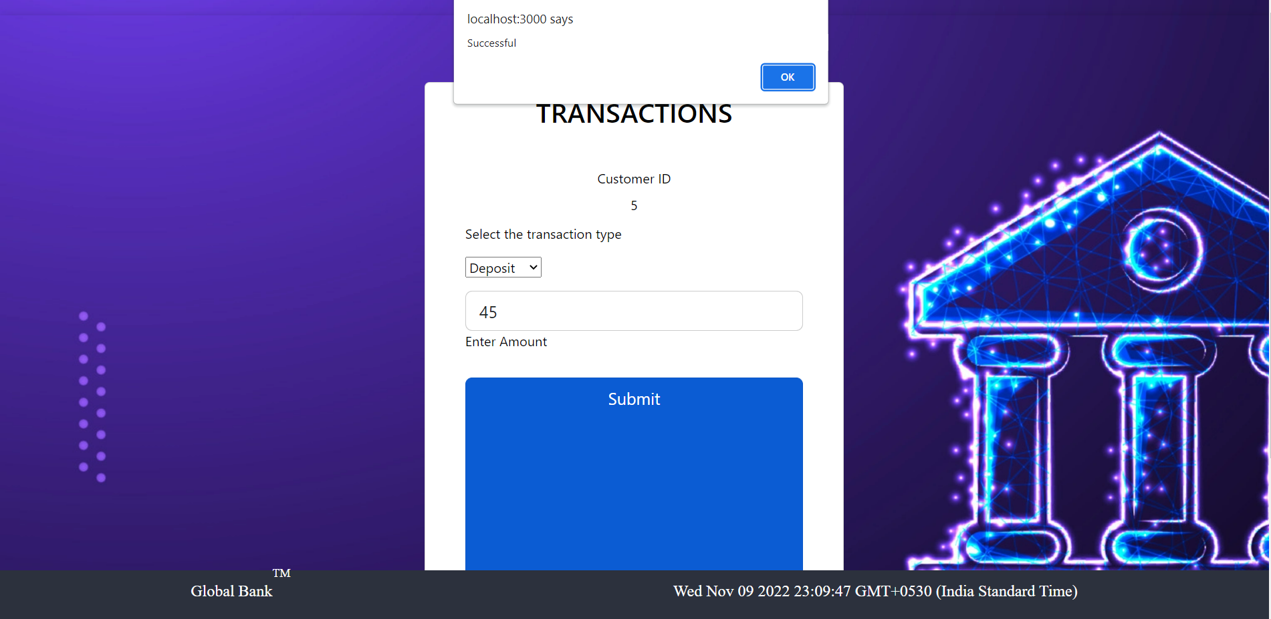
PROMPT FOR SUCCESSFUL DEPOSIT

Slide 19
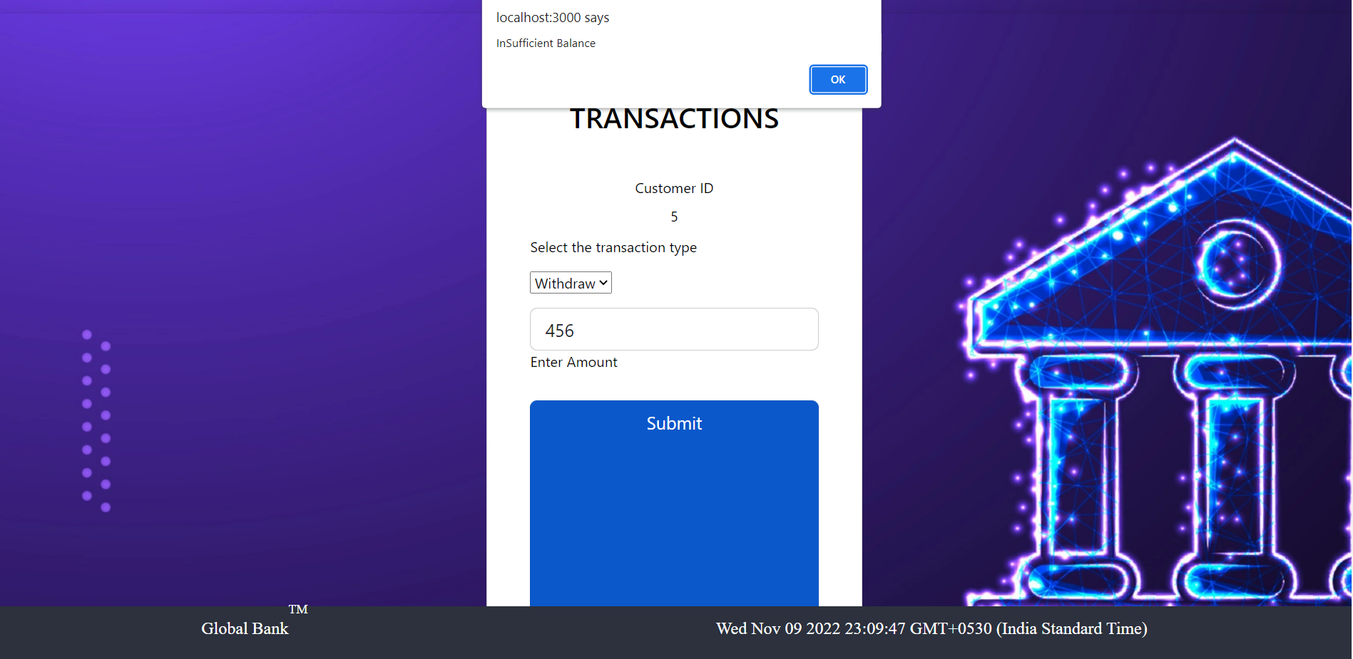
PROMPT FOR INSUFFICIENT BALANCE

Slide 20
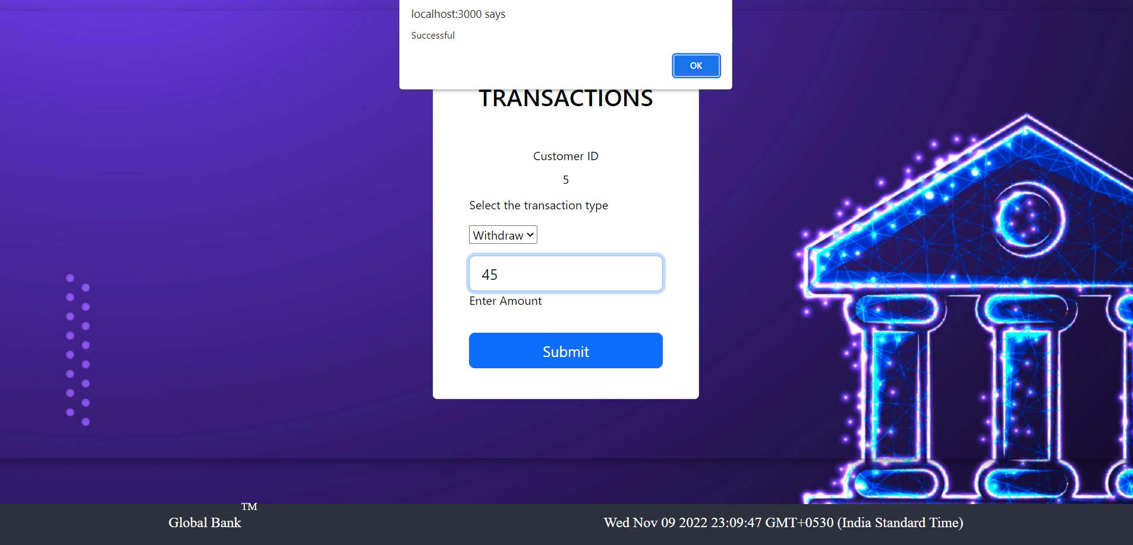
PROMPT FOR SUCCESSFUL WITHDRAW

Slide 21
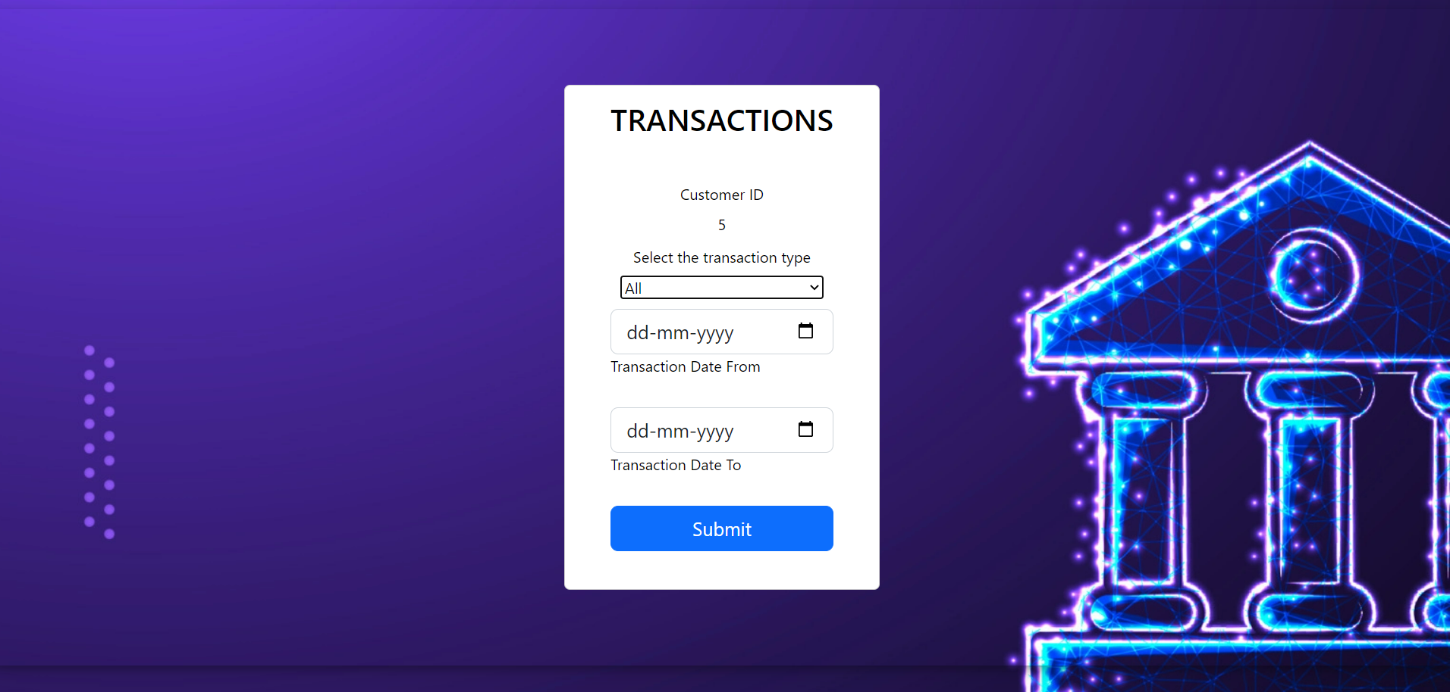
VIEW STATEMENT

Slide 22
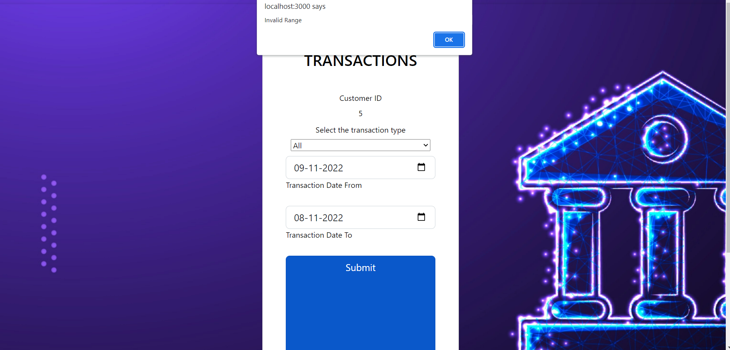
INVALID RANGE PROMPT

Slide 23
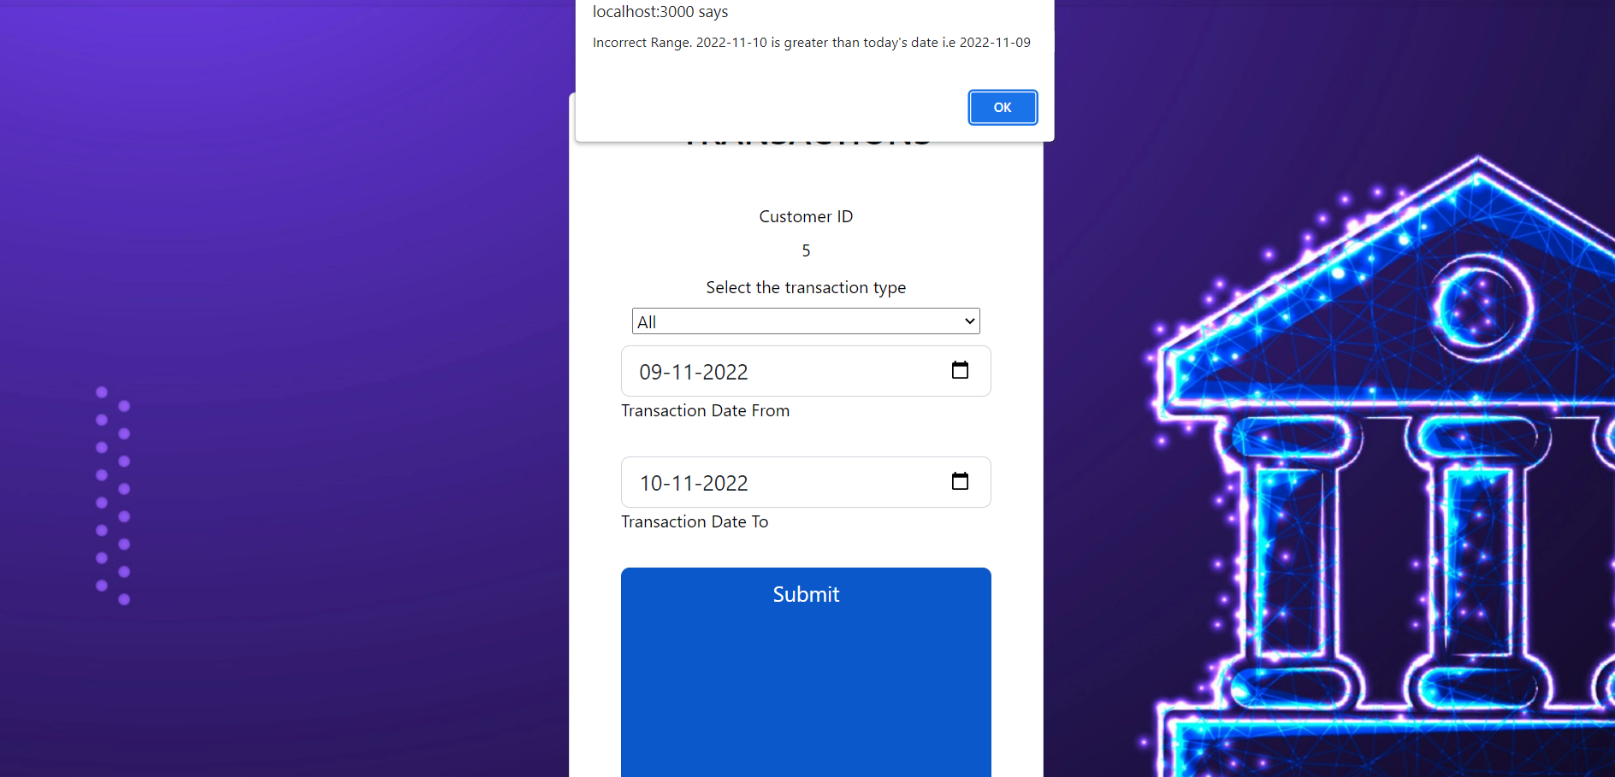
INCORRECT DATE PROMPT

Slide 24
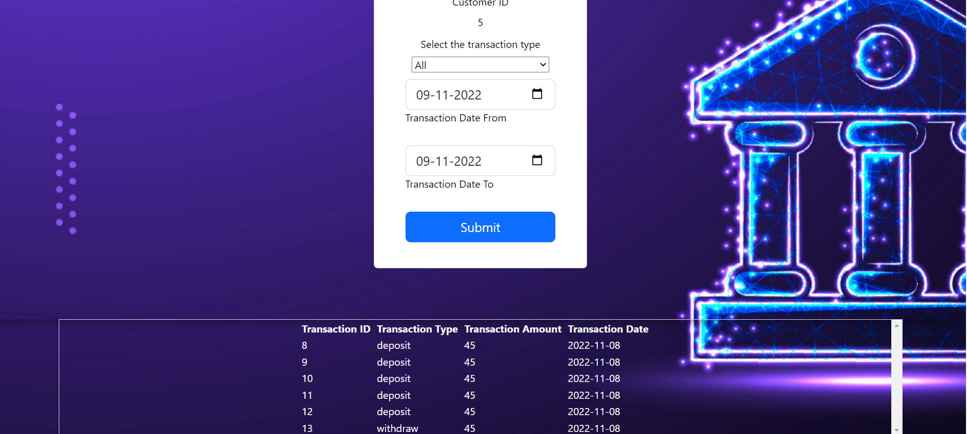
SUCCESS! LIST OF TRANSACTIONS

Slide 25
THANK YOU

